Slide 1
Create your first Blockchain
Hands-on lab to create your first Blockchain Business Network
Chris Tyler
Technical Evangelist

Slide 2
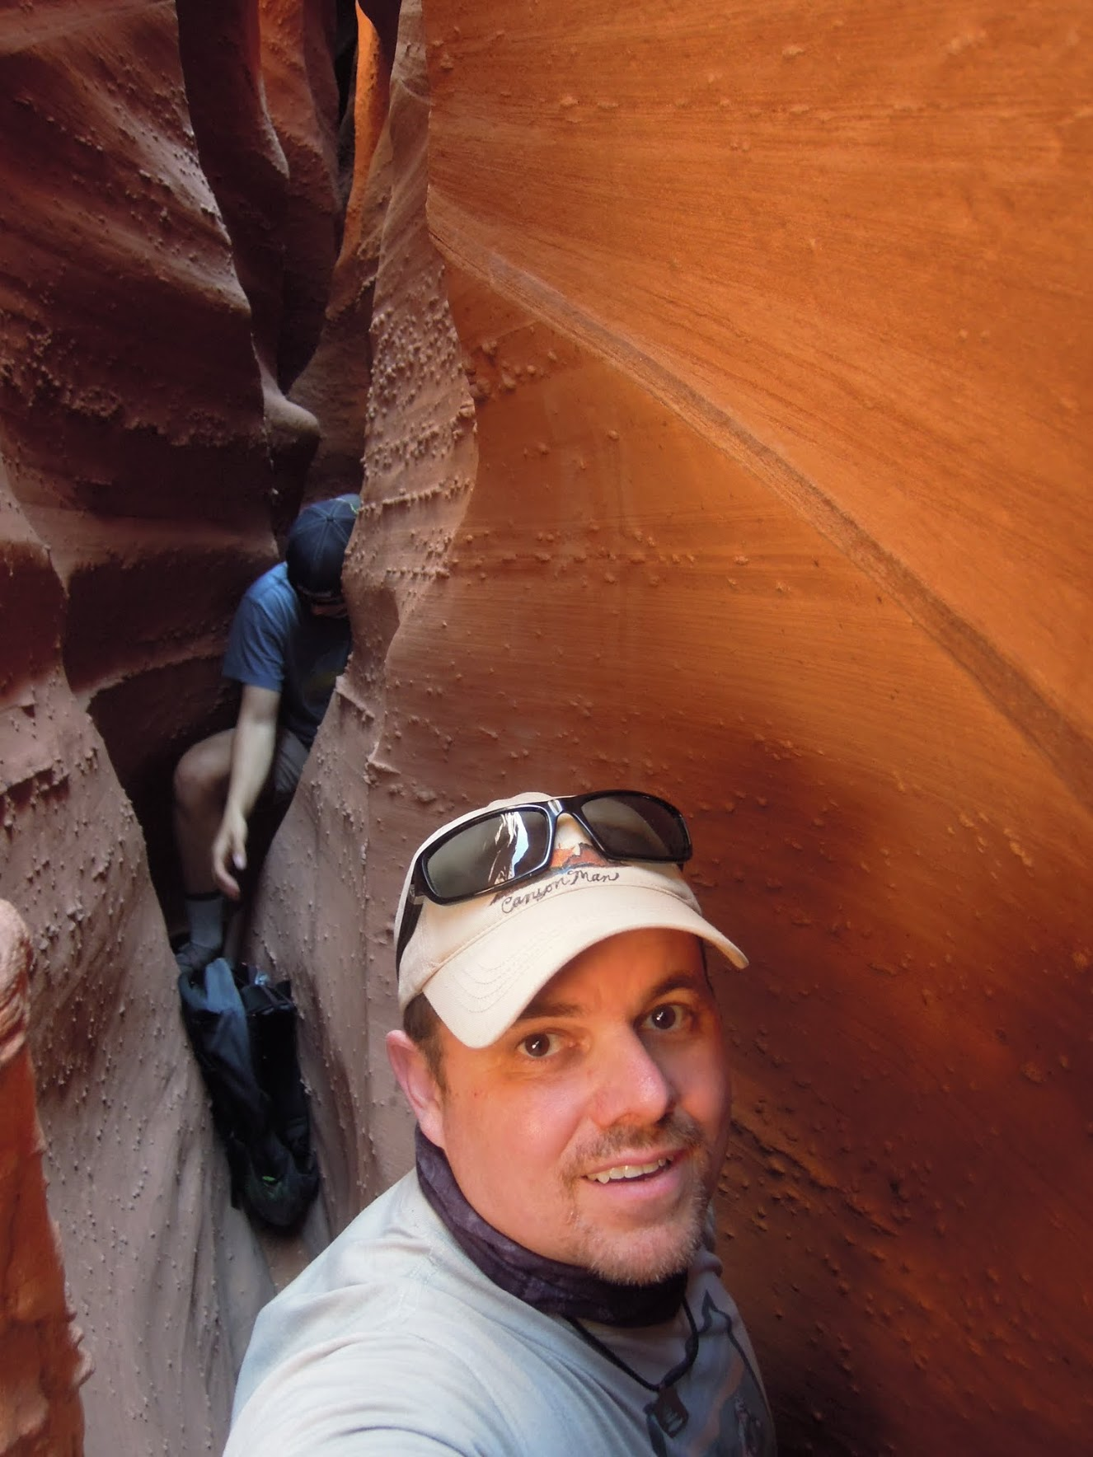

Chris A Tyler
Cloud and Cognitive Technical Evangelist
Part of the IBM WolfPack Evangelist Team - @IBMWolfPack
25+ years in analytics and data
15 years with IBM Analytics
Past year with IBM Cloud
Current focus is on Blockchain and IoT
Outside work, I’m an avid outdoorsman, known as the CanyonMan
Enjoy hiking, backpacking and fly fishing
Twitter - @ChrisATyler and @the_CanyonMan
LinkedIn – ChrisATyler
@IBMWolfPack

Slide 3
1
What is Blockchain
2
Why should you use Blockchain
3
What Blockchain isn’t
4
5
What is Blockchain for Business
What is IBM Blockchain
6
Hyperledger Composer
7
Hands-on lab
8
Conclusion
Notes:
Today should be an exciting day. We’re going to spend a bit of time first to understand what is Blockchain and why there is so much interest and excitement around it.
Then, we’ll focus briefly on what Blockchain isn’t. This is important, because it fits a certain use case profile and there are some places where Blockchain maybe isn’t a fit.
Next, we’ll focus on Blockchain for Business and what is IBM Blockchain, which is built on Hyperledger Fabric.
Before getting into the lab, we’ll give you a brief overview of Hyperledger Composer, the development tool for building Blockchain applications for Hyperledger Fabric and IBM Blockchain.
Then, we’ll finish up.
Let’s get started.

Slide 4
What is Blockchain
An introduction to the Blockchain concepts
Notes:
Blockchain is one of the hottest technology topics going now. For our team, Blockchain, IoT and Machine Learning are probably the top 3 topics asked about.
How many of you have some experience with Blockchain? How many are building applications with Blockchain?
We’re going to do a quick level set of what Blockchain is and what some of the main concepts and components are.

Slide 5
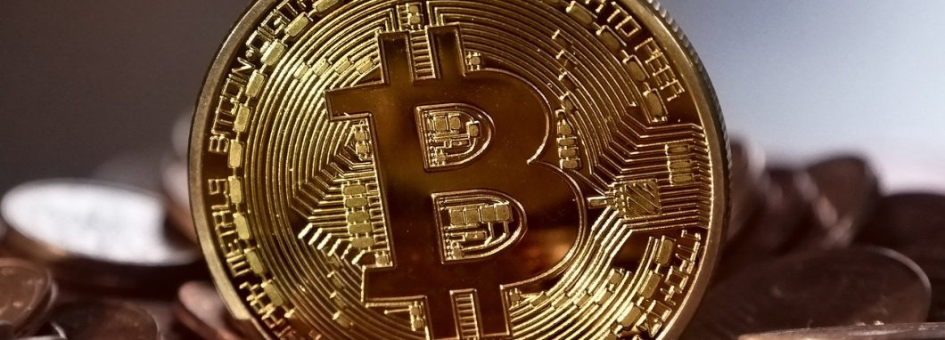
Is blockchain Bitcoin?
Notes:
First and foremost, Blockchains are built around a Business Network. A Business Network is a group of entities that are working towards a common goal, be that improving supply chain processes and transparency or making electronic trade and commerce cheaper and faster.
These Business Networks benefit from connectivity which makes it faster, easier and cheaper to do business, but there is a need for security as well. Participants in these networks can all play different roles such as customers, suppliers, banks, partners, regulators, etc. They may even cross geographic, political and regulatory boundaries.
Wealth or value is created when goods and services flow through the network. Anything that slows that transfer down, increases costs and decreases profitability. The complexity in contractual terms and conditions and the need for manual intervention are often the causes for this.
Finally, these networks are generally centered around a specific market, which can be a public market or a private market. And these markets are designed to facilitate the trade of goods and services.

Slide 6
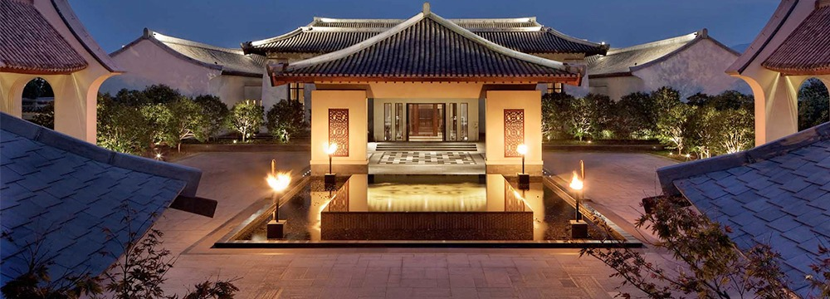
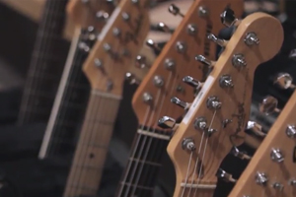

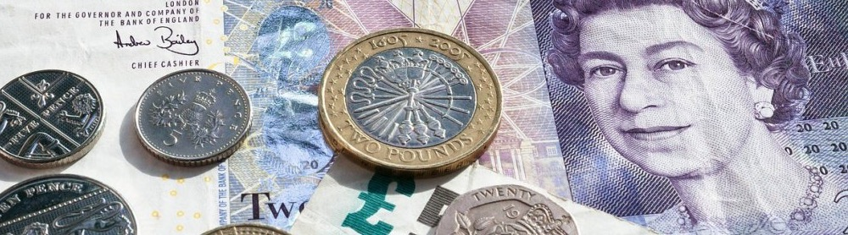
Assets are varied, traded and have value
Notes:
These goods and services are assets. Assets can be either tangible or intangible.
Tangible assets are easy to understand. People buy and sell property, cars, products, etc. Intangible assets are a little more challenging to understand, but even when you buy or sell a house, there are other assets involved. There is the financial instrument of the mortgage, there is the title. In the entertainment business, there are digital rights. In the business world, there are patents and contracts. Cash is even an asset.
Most people associate Blockchain with Cryptocurrencies. It’s true that Blockchain is the platform for the tracking and trading of Cryptocurrencies, but it’s only one use for this technology.
And, just like the tracking and tracing of Cryptocurrencies, all transactions need to be tracked and traceable. This is done through a ledger.

Slide 7
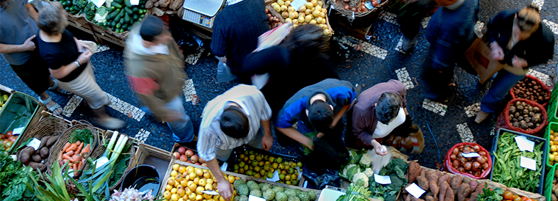
Assets are traded within business networks or markets
Notes:
These goods and services are assets. Assets can be either tangible or intangible.
Tangible assets are easy to understand. People buy and sell property, cars, products, etc. Intangible assets are a little more challenging to understand, but even when you buy or sell a house, there are other assets involved. There is the financial instrument of the mortgage, there is the title. In the entertainment business, there are digital rights. In the business world, there are patents and contracts. Cash is even an asset.
Most people associate Blockchain with Cryptocurrencies. It’s true that Blockchain is the platform for the tracking and trading of Cryptocurrencies, but it’s only one use for this technology.
And, just like the tracking and tracing of Cryptocurrencies, all transactions need to be tracked and traceable. This is done through a ledger.

Slide 8
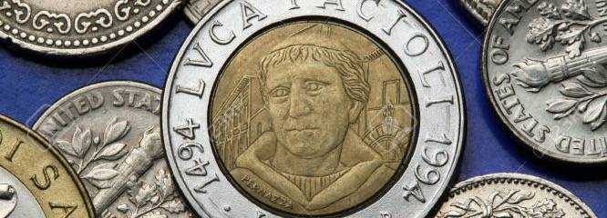
Ledgers track transactions, but this isn’t new
Notes:
These goods and services are assets. Assets can be either tangible or intangible.
Tangible assets are easy to understand. People buy and sell property, cars, products, etc. Intangible assets are a little more challenging to understand, but even when you buy or sell a house, there are other assets involved. There is the financial instrument of the mortgage, there is the title. In the entertainment business, there are digital rights. In the business world, there are patents and contracts. Cash is even an asset.
Most people associate Blockchain with Cryptocurrencies. It’s true that Blockchain is the platform for the tracking and trading of Cryptocurrencies, but it’s only one use for this technology.
And, just like the tracking and tracing of Cryptocurrencies, all transactions need to be tracked and traceable. This is done through a ledger.

Slide 9
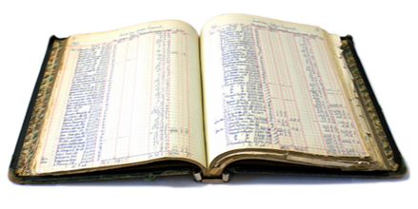
Ledgers aren’t perfect
Notes:
The ledger is the key to the success of a network or a market. Ledgers are the system of record. It tracks all transactions which involve the transfer of assets between participants. To ensure that the transaction is agreeable between participants, there is generally a contract. The contract spells out the terms and conditions of the trade.
Blockchain keeps a running ledger of every transaction that occurs in a business network. Each participant in the transaction is associated with the transaction and must endorse the transaction and that is all tracked and traceable through the ledger.
So, why use Blockchain? Lot’s of applications today have ledgers built into them. Almost every ERP or Accounting system has a ledger. Let’s explore that next.

Slide 10
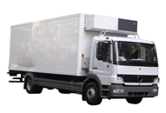
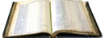
The challenge with ledgers in a business network
Participant A’s records
Participant B’s records
Bank records
Auditor
Insurer
Regulator
… inefficient, expensive, vulnerable
Notes:
The ledger is the key to the success of a network or a market. Ledgers are the system of record. It tracks all transactions which involve the transfer of assets between participants. To ensure that the transaction is agreeable between participants, there is generally a contract. The contract spells out the terms and conditions of the trade.
Blockchain keeps a running ledger of every transaction that occurs in a business network. Each participant in the transaction is associated with the transaction and must endorse the transaction and that is all tracked and traceable through the ledger.
So, why use Blockchain? Lot’s of applications today have ledgers built into them. Almost every ERP or Accounting system has a ledger. Let’s explore that next.

Slide 11
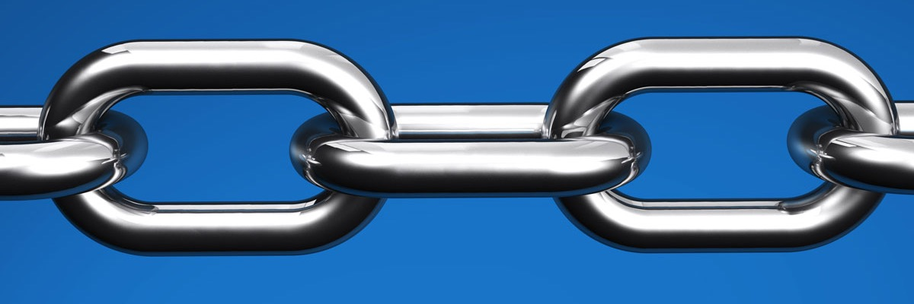
Blockchain and the immutable, shared ledger
Notes:
The ledger is the key to the success of a network or a market. Ledgers are the system of record. It tracks all transactions which involve the transfer of assets between participants. To ensure that the transaction is agreeable between participants, there is generally a contract. The contract spells out the terms and conditions of the trade.
Blockchain keeps a running ledger of every transaction that occurs in a business network. Each participant in the transaction is associated with the transaction and must endorse the transaction and that is all tracked and traceable through the ledger.
So, why use Blockchain? Lot’s of applications today have ledgers built into them. Almost every ERP or Accounting system has a ledger. Let’s explore that next.

Slide 12

Blockchain resolves some of the challenges
Participant A’s records
Participant B’s records
Bank records
Blockchain
Auditor
Insurer
Regulator
… with consensus, provenance, immutability and finality
Notes:
The ledger is the key to the success of a network or a market. Ledgers are the system of record. It tracks all transactions which involve the transfer of assets between participants. To ensure that the transaction is agreeable between participants, there is generally a contract. The contract spells out the terms and conditions of the trade.
Blockchain keeps a running ledger of every transaction that occurs in a business network. Each participant in the transaction is associated with the transaction and must endorse the transaction and that is all tracked and traceable through the ledger.
So, why use Blockchain? Lot’s of applications today have ledgers built into them. Almost every ERP or Accounting system has a ledger. Let’s explore that next.

Slide 13

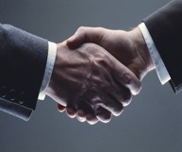
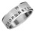
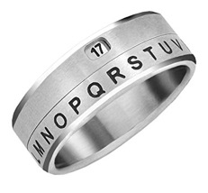
How it works (oversimplification)
Transaction
Transaction Type | Home Sale
Asset id | 12345
Date | 02/15/2018
Buyer | 838959
Seller | 939384
Purchase Amount | $750,000 USD
Description | Home
Address | 177A Bleeeker Street
Proposed Block
Transaction Type | Home Sale
Current Hash | 827ccb
Previous Hash | 52778b
Morgtage Co.
Title Co.
827ccb | 52778b | ✅
827ccb | 52778b | ✅
Insurance Co.
Buyer Realtor
827ccb | 52778b | ✅
827ccb | 52778b | ✅
Seller Realtor
827ccb | 52778b | ✅
The shared, immutable ledger
Transaction Type | Current Hash | Previous Hash
Home Inspection | 5778b | 935k6d
Home Sale | 827ccb | 52778b
Mortgage Created | 9385j7 | 827ccb
Notes:
The ledger is the key to the success of a network or a market. Ledgers are the system of record. It tracks all transactions which involve the transfer of assets between participants. To ensure that the transaction is agreeable between participants, there is generally a contract. The contract spells out the terms and conditions of the trade.
Blockchain keeps a running ledger of every transaction that occurs in a business network. Each participant in the transaction is associated with the transaction and must endorse the transaction and that is all tracked and traceable through the ledger.
So, why use Blockchain? Lot’s of applications today have ledgers built into them. Almost every ERP or Accounting system has a ledger. Let’s explore that next.

Slide 14
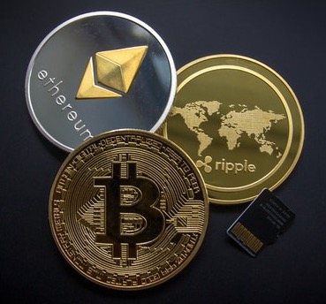

Crypto-currency and crypto-assets

Slide 15
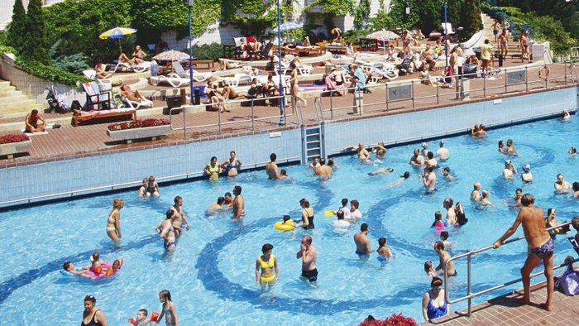

Public and private

Slide 16
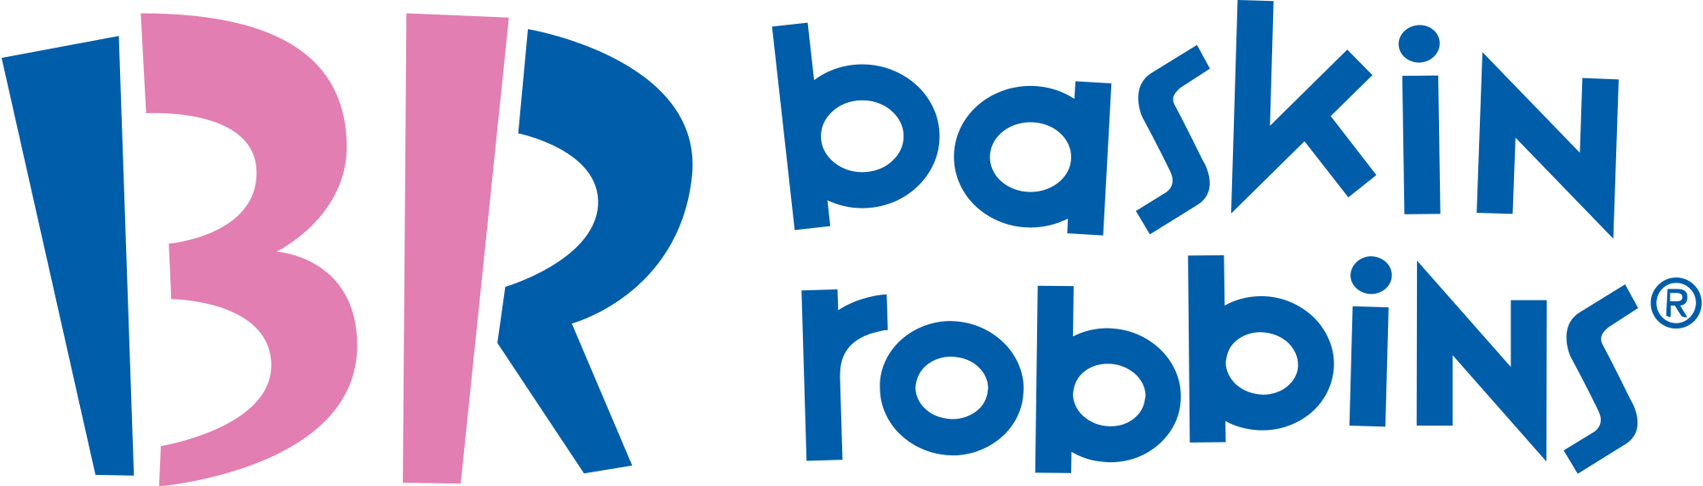
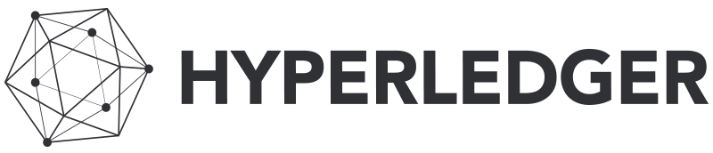

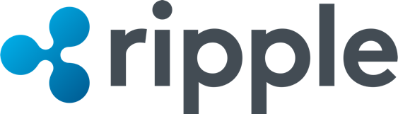
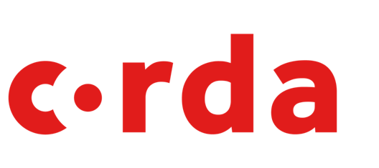
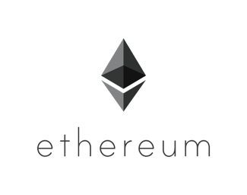
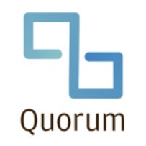
Different types of blockchain – 31 flavors

Slide 17
Why use Blockchain
What challenges does Blockchain address
Notes:
Why should we use Blockchain? What challenges with existing systems and processes does it address?

Slide 18
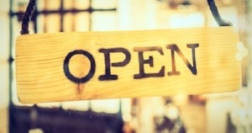
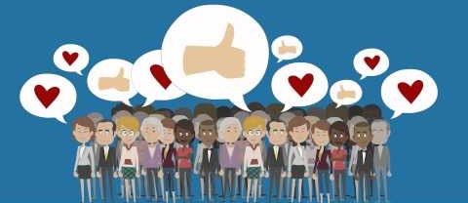
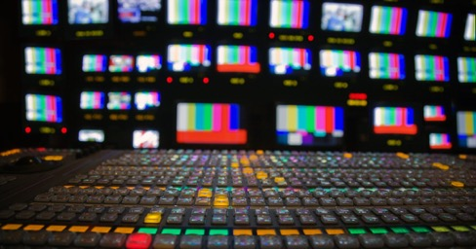
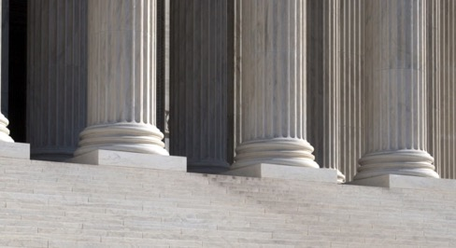
Is blockchain right for my business process

Slide 19
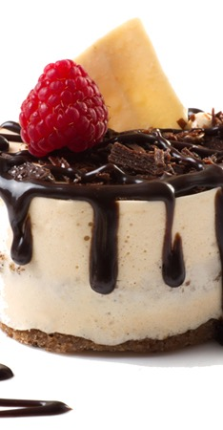
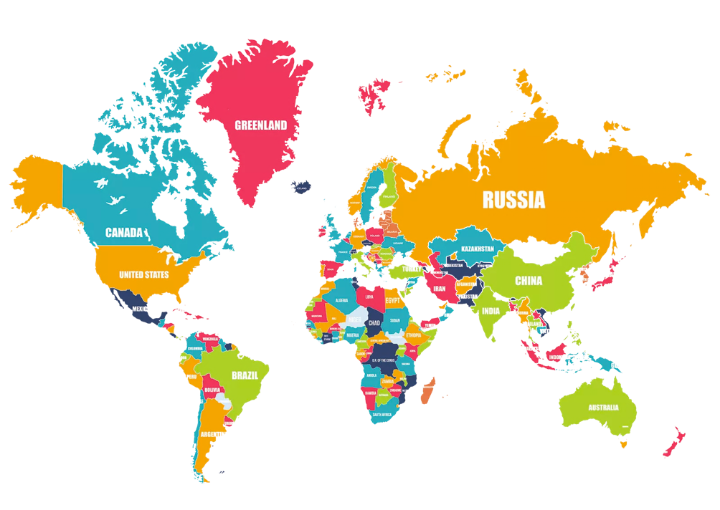
Food Safety – Traceability and Transparency
40,000+ Food Miles

Slide 20
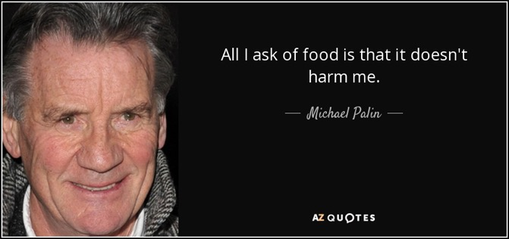
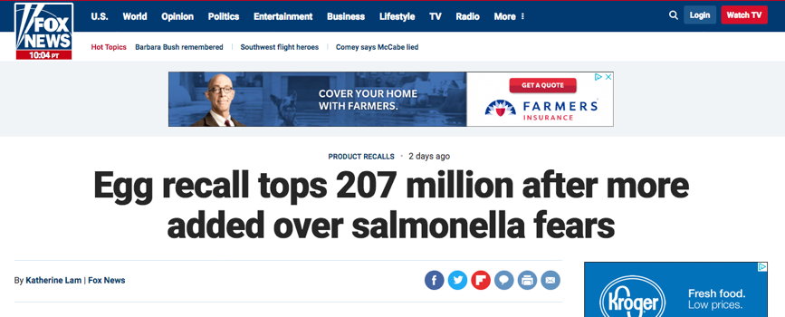
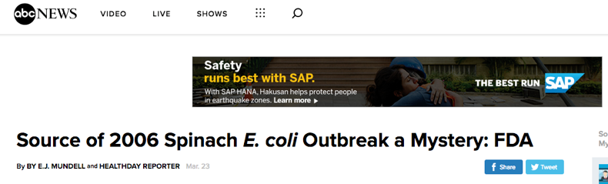

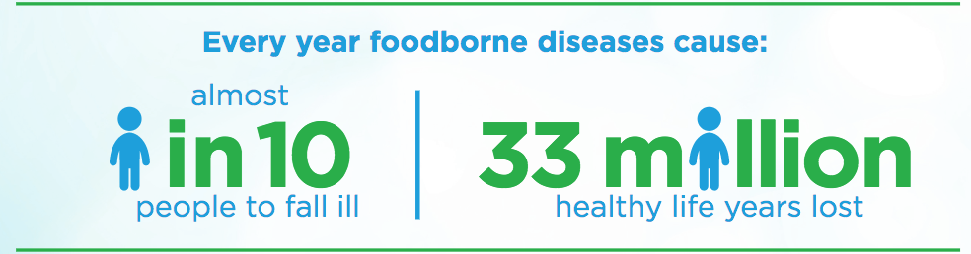
Food Safety - Risks

Slide 21
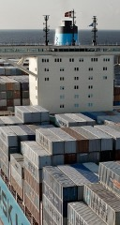
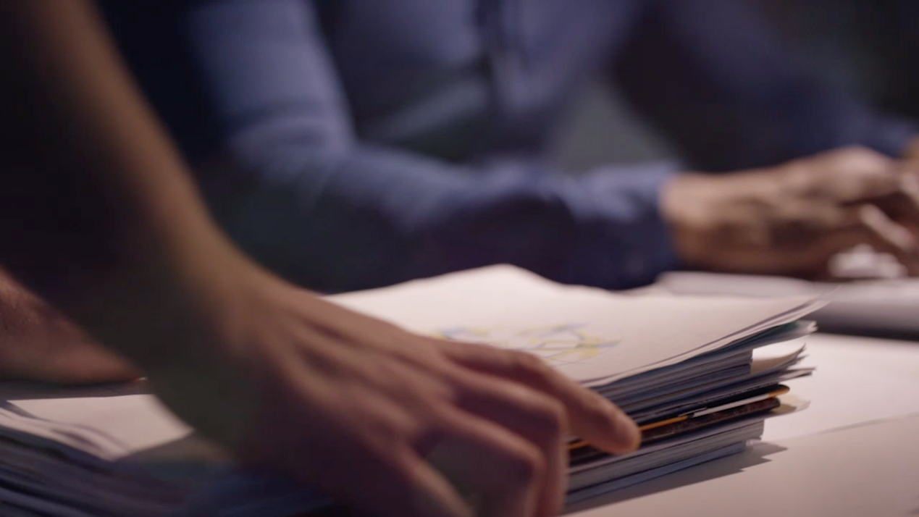
Transportation and Logistics – Eliminating Inefficiencies
$180 Billion Cost Savings

Slide 22
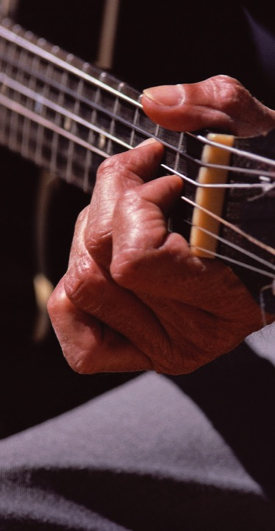
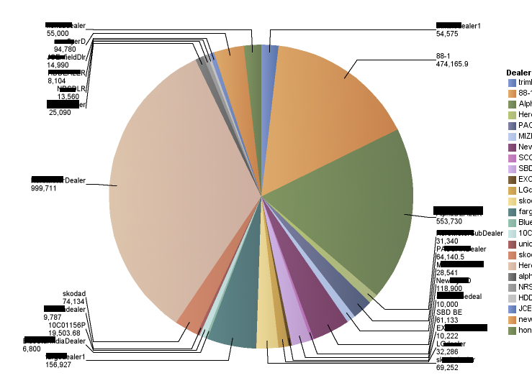
Music Industry – Digital Rights and Royalty Transparency
20%-50% Royalties

Slide 23
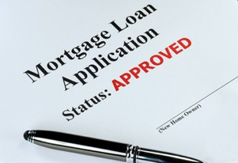
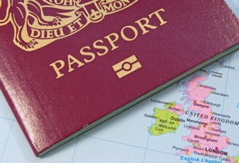
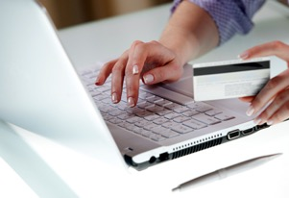
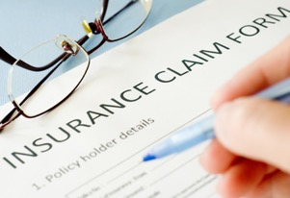
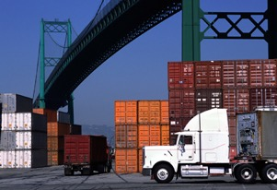
Further examples by (selected) industry
Financial | Public Sector | Retail | Insurance | Manufacturing
Trade Finance Cross currency payments Mortgages | Asset Registration Citizen Identity Medical records Medicine supply chain | Supply chain Loyalty programs Information sharing (supplier – retailer) | Claims processing Risk provenance Asset usage history Claims file | Supply chain Product parts Maintenance tracking
Notes:
There are use-case examples everywhere, and we’re still in the early days of understanding the potential. Also be aware that many use-cases (e.g. supply chain) are cross industry.
For an active list of use cases by industry on the IBM intranet: http://ibm.biz/BlockUseCases

Slide 24
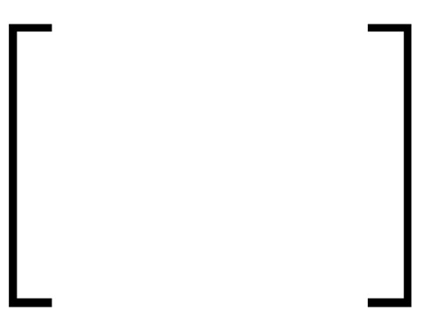

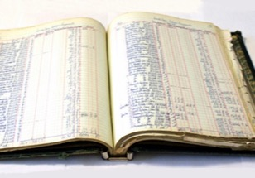
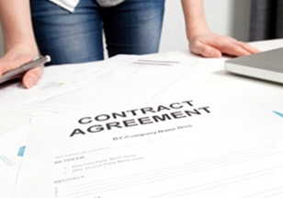
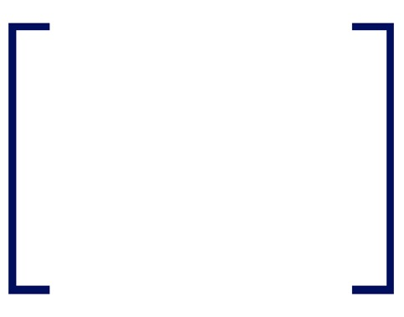
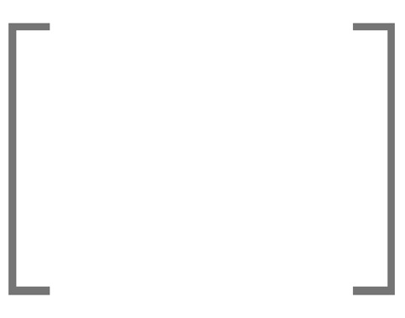
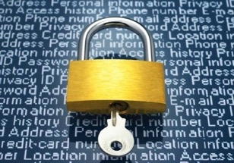
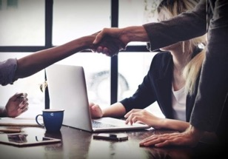
Blockchain for business requires trust
Shared ledger
Smart
contract
Append-only distributed system of record shared across business network
Business terms executed with transactions
Transactions are secure with appropriate visibility
Transactions are provably endorsed by relevant participants
Privacy
Proof
Notes:
Blockchain for business comprises these four main blocks, that can lead to increased efficiencies, and cost reduction across the business network. Together they add TRUST to a business network.
Shared ledger and Smart Contract are the ‘things’ that constitute blockchain
Privacy and the ’proof’ are the qualities of service.

Slide 25
IBM Blockchain
What is IBM Blockchain

Slide 26
IBM Blockchain brings together the world’s most advanced expertise, technology and ecosystem to transform industries
Experts
Collaborate with comprehensive services teams from ideation all the way to production
Solutions
Solve critical industry challenges by building and joining new business networks
Hyperledger
As a founding and premier member of Hyperledger, we’re committed to open source, standards and governance
Platform
Develop, govern and operate enterprise blockchain networks with speed and security
Notes:
From Ideation to PoC to Pilot to production. You need to be able to quickly develop, deploy and operate with stability and consistency.
The most complete and production ready platform is comprised of 3 main lifecycle capabilities meant to develop blockchain apps and activate blockchain networks at speed and scale. and finally, simplify and standardize network operations
IBM can provide:
1. a developer sandbox in the cloud for rapid iteration and prototyping
having an environment that doesn't take 6months to a year to build on your own and Millions of dollars to basic it plumbing...key management,
2. a complete production ready runtime as well that now includes a set of native governance tools that help solve difficult multi-party problems
3. 24x7 integrated service, production hardened to optimize for performance and resiliency with an architecture that is all automated and instrumented as a modern cloud service

Slide 27
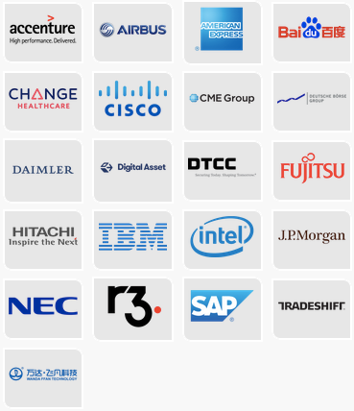
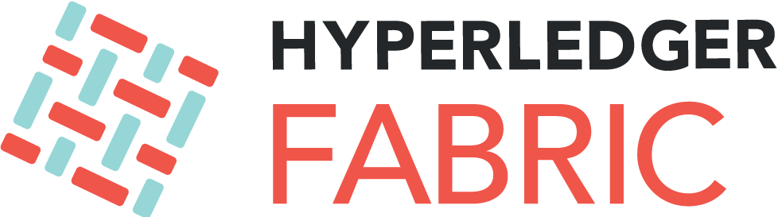




IBM Blockchain Technology

Slide 28


IBM Blockchain Guidance - Garage Method
Discovery Workshop Understand market opportunities and select a use case that represents the value your organization and business network is looking to gain while also gaining a deeper insight into blockchain technology. Length: ½ Day | Design Thinking Workshop Apply IBM Design Thinking principles to evaluate current business processes, identify business network and define the minimal viable product for your blockchain solution. Length: 2 days
Architectural Consultancy Enlist the support of a blockchain architect in an IBM Cloud Garage to help define the framework of your blockchain solution. Length: 1 week | MVP Build-up Develop a functioning blockchain solution using agile methodologies, leveraging experts in IBM Blockchain, UX/UI design and development, and cloud architecture. Length: 4–10 weeks

Slide 29




IBM Blockchain Partners
Notes:
Northern Trust – Private Equity use case
“This is an important first step to connecting participants much more effectively, including investors, managers, administrators, regulators, advisors and auditors.”

Slide 30
Hands-on Lab
Building your first Blockchain Business Network
Notes:
Now, let’s see it in action. We’re going to work with a Business Network in Hyperledger Composer.

Slide 31
Lab Agenda
Building your first blockchain business network
1
Hyperledger Composer Concepts
2
Access the Composer Playground
3
Modeling Language Basics
4
Build the Network
5
Test the Network
6
Export the Network
Notes:
But first, we need to understand some common Hyperledger Composer Concepts
We will use a free, cloud instance of Hyperledger Composer called the Composer Playground
We will give you the basics of the Composer Modeling Language
You will build a network from a template
You will test that network
Finally, we’ll export the network so you can save your work

Slide 32
Conclusion
Notes:
Thank you for your time today, hopefully, you now better understand Blockchain and have a good understanding of how to develop a network with Hyperledger Composer

Slide 33
http://bit.ly/WPLDallas053118
Notes:
Please complete the survey at the link below.
Thank you and have a great day

